Slide 1



R U a H@ck3r?

Slide 2

Write
3 Dream Jobs
3 Things You’re Doing Today
3 Things You’ve Learned
TEST!

Slide 3

Identity Paradox
Who am I?
How do you know?
How do I prove it to you?
Without compromising my privacy?

Slide 4
I’d tell you who I really am, but do you really care?
Ron Woerner
Cybersecurity Professor, Bellevue University
Chief Hacking Officer, Cyber-AAA

Slide 5
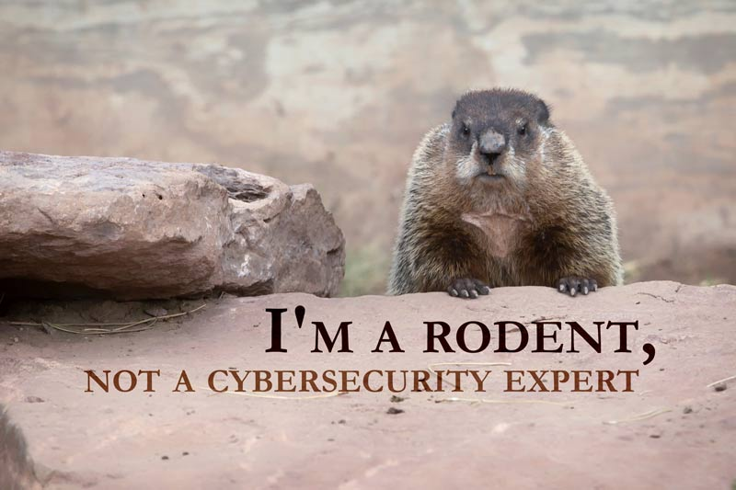
What the $%$# are we doing here?

Slide 6
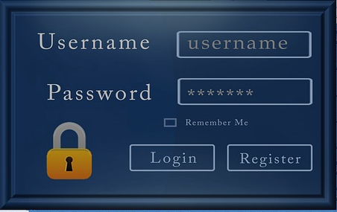
PWNED!!!

Slide 7

Billions Lost!
Black Hat Hackers
Notes:
Image: https://pellcenter.org/wp-content/uploads/2015/11/Mushroom-Cloud.jpg

Slide 8

Cyber War!
Notes:
Image: https://pellcenter.org/wp-content/uploads/2015/11/Mushroom-Cloud.jpg

Slide 9


WANTED:
HACKERS
reward
Notes:
Photo Source: This Photo by Unknown Author is licensed under CC BY-NC

Slide 10
Hackers Dictionary
Hacker: “One who enjoys the intellectual challenge of creatively overcoming or circumventing limitations.”
Raymond, E., The Jargon Lexicon, Glossary, http://catb.org/jargon/html/H/hacker.html

Slide 11

Hacking 101
Notes:
Photo Source: This Photo by Unknown Author is licensed under CC BY-NC

Slide 12
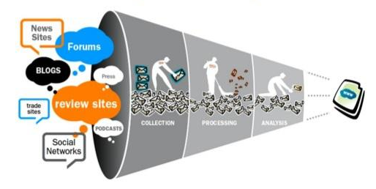
OSInt
Open Source Intelligence
Data Collection from public sites
Reconnaissance

Slide 13
Hacking 101
Learn it
Google
Explore it
Break it
(with permission)
Fix it
Make it better
Tell others

Slide 14

How To Become a Hacker – EPIC HOW TO - YouTube
https://www.youtube.com/watch?v=tlezBUdD53w

Slide 15

An Introduction to Cybersecurity Careers
https://youtu.be/-AkuKKJ8dN0

Slide 16
Website Tracking Demo
Notes:
Photo Source: This Photo by Unknown Author is licensed under CC BY-NC

Slide 18

Hacking Your Career

Slide 19

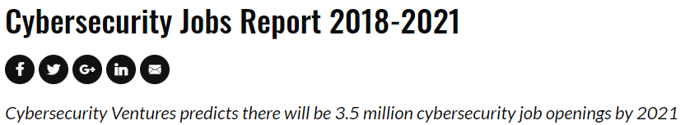
https://cybersecurityventures.com/jobs/

Slide 20
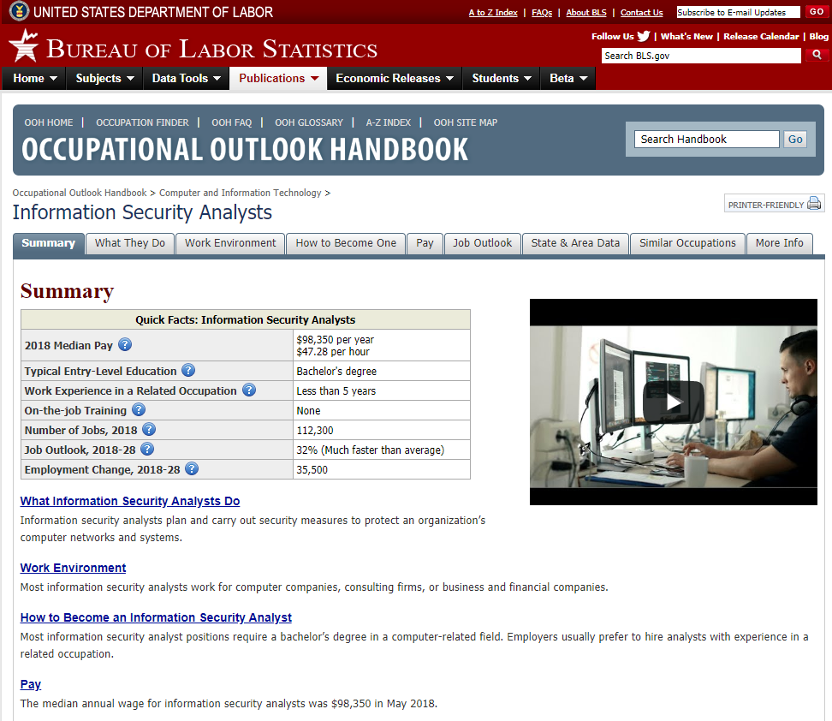
https://www.bls.gov/ooh/computer-and-information-technology/information-security-analysts.htm

Slide 21
Goals
Finding, landing and keeping a job in cybersecurity
What’s best for your Cybersecurity career: a certification or a degree?
Strategic (GRC) vs. Tactical (Technical)

Slide 22
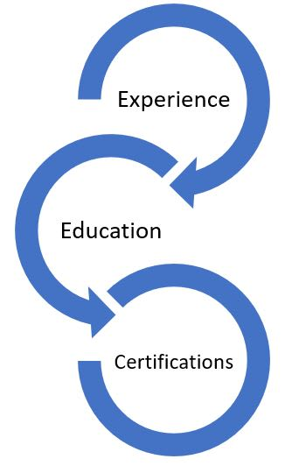
Requirements
Tech Skills
Personal Abilities
Functional Knowledge

Slide 23
Getting Experience
Practice, practice, practice
Set up your own home lab
Mentor
Volunteer
CTFs
Get your foot in the door
PC Support / Technician
Help / Service Desk

Slide 24

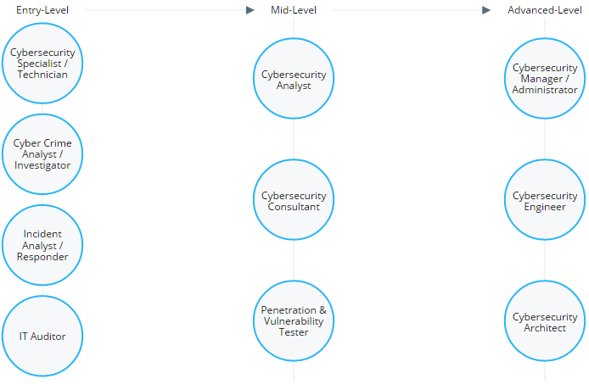
Cybersecurity Career Pathway
https://www.cyberseek.org/pathway.html

Slide 25
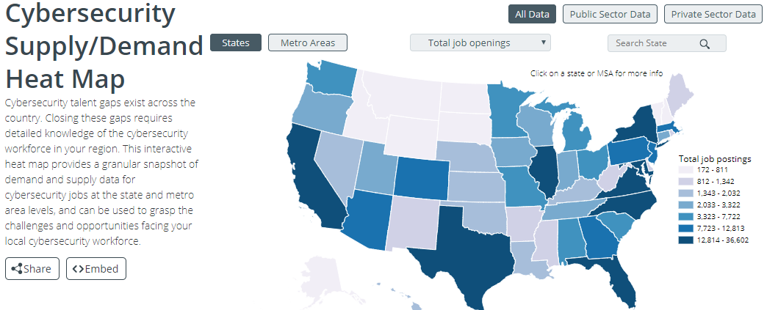
https://www.cyberseek.org/heatmap.html

Slide 26
Building Knowledge
Education / Degrees
MCC UNO Bellevue
Training / Certifications
ISC²
ISACA
SANS
Offensive Security
EC-Council

Slide 27
Other stuff you need / Functional Abilities
Attitude (preferably good)
Communications (Writing & Speaking)
Teamwork
Critical Thinking
Tenacity

Slide 28
Hacking Your Career Tips
Visualize Your Goals – what do you want to be when you grow up & why?
Social Engineer Your Next Boss
Be Open to Opportunities
Actively Learn
Practice, Practice, Practice
Be a Hacker

Slide 29
Blogs & Resources
Choosing Your Cybersecurity Career Path: https://www.peerlyst.com/posts/choosing-your-cybersecurity-career-path-ron-Woerner
Breaking into Security Careers - 2018: https://www.peerlyst.com/posts/breaking-into-security-careers-2018-ron-woerner
Cybersecurity Careers: Hacking Your Next Job: https://www.peerlyst.com/posts/cybersecurity-careers-hacking-your-next-job-ron-woerner

Slide 30
Blogs & Resources
Peerlyst Career Wiki - https://www.peerlyst.com/posts/a-collection-of-links-about-transitioning-into-infosec-or-starting-an-infosec-career-and-making-it-peerlyst
“Breaking into Security,” (podcast), Renee Small and Christophe Foulon, https://podcasts.apple.com/us/podcast/breaking-into-cybersecurity/id1463136698
Breaking Into Information Security, (book)

Slide 31
Other Resources
Living Security, Cyber Security Top 10 best games to make your employees aware, https://livingsecurity.com/blog/10-best-games-cyber-security/
Threat Vector, “Three Different Ways Teens Can Get Phished,” https://threatvector.cylance.com/en_us/home/three-different-ways-teens-can-get-phished.html

Slide 32
Write
3 Dream Jobs
3 Things You’re Doing Today
3 Things You’ve Learned
TEST!

Slide 33
Security Groundhog Day
Ron Woerner
Cyber-AAA, LLC
ronw@cyber-aa.com
Twitter: @ronw123
Bellevue University
rwoerner@Bellevue.edu

